Slide 1

AHT National Finals
Competitions
12.5.2025
Blackpool

Slide 2
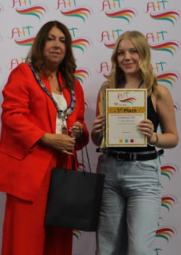
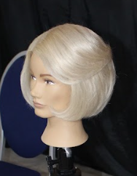
Comp 1: 1st Year Blow Dry
1st Place
Competitor: Jodie Stanton
College: IEG Stanford
(Midlands)

Slide 3
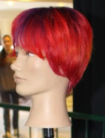
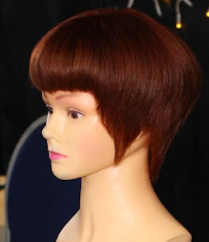
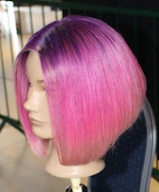
Comp 1: 1st Year Blow Dry
2nd Place | 3rd Place | 4th Place
Courtney Grey Tyne Coast (NE) | Skye Ingram Hartlepool (NE) | Taylor Thompson Tyne Coast (NE)

Slide 4
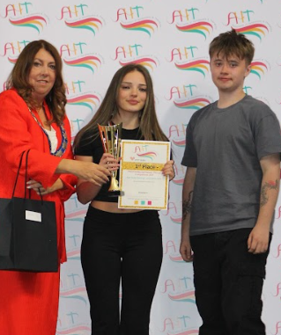
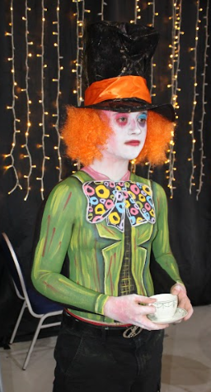
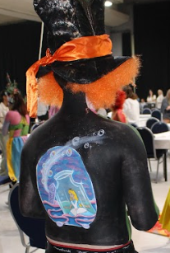
Comp 2: Body Painting Theme: Animated Films
1st Place
Competitor: Katie Leigh Hindmarch
College: Gateshead
North East

Slide 5
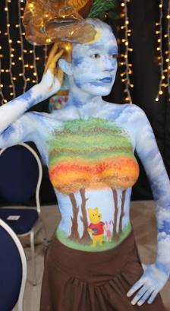
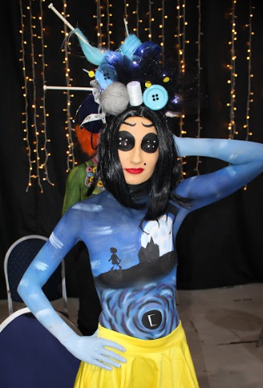
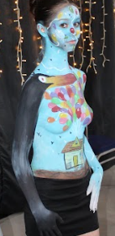
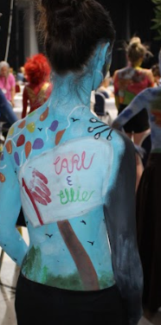
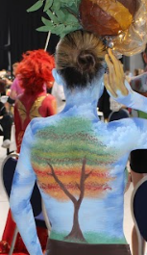
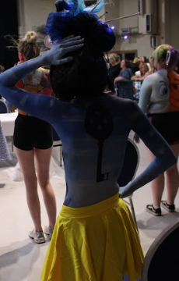
Comp 2: Body Painting - Animated Films
2nd Place | 3rd Place | 4th Place
Chloe Oztoprak Bristol (SW) | Sky Machel-Machajova Bristol (SW) | Chloe Goom Middlesborough (NE)

Slide 6
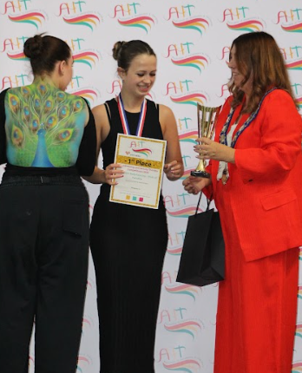
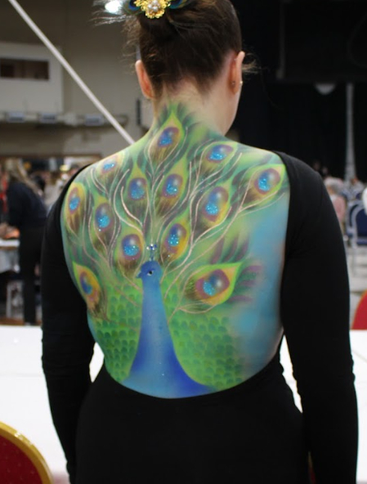
Comp 3: Airbrush Body Painting
Theme: Birds of Paradise
1st Place
Competitor: Amelia Hayward
College: NWSLC - Midlands

Slide 7
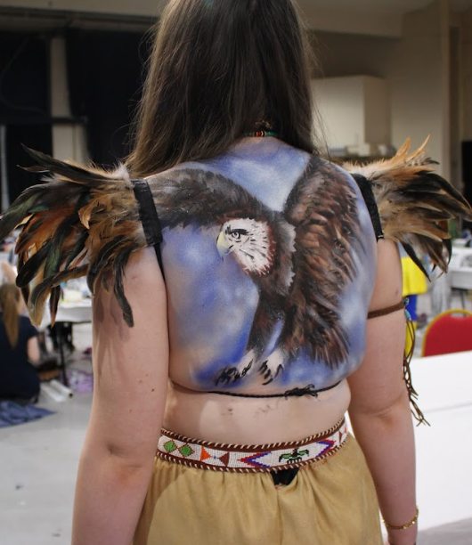
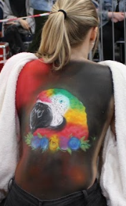
Comp 3: Airbrush Body Painting - Birds of Paradise
2nd Place | 3rd Place | 4th Place
Vicki Teggart NWSLC (Mid) | Samantha Savage NWSLC (Mid) | NA

Slide 8
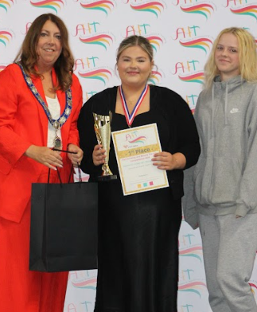
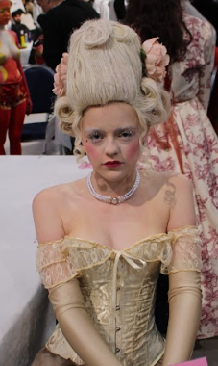
Comp 4: Classical Make-up - Renaissance
1st Place
Competitor: Rosie Croker
College: City of Bristol (SW)

Slide 9
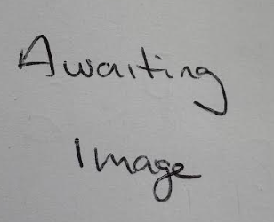
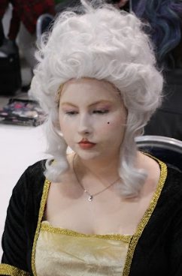
Comp 4: Classical Make-up - Renaissance
2nd Place | 3rd Place | 4th Place
Lily Wilson New College Durham (NE) | You Hayden Manchester (NW) | David Cutler Hartlepool (NE)

Slide 10
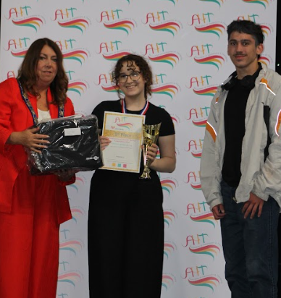

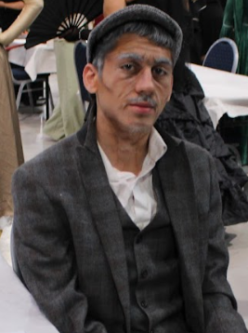
Comp 5: Theatrical Ageing Make-up
1st Place
Competitor: Lexy Brown
College: City of Bristol (SW)

Slide 11
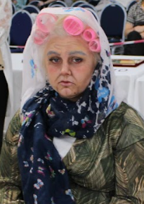
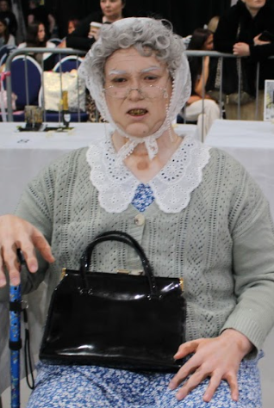
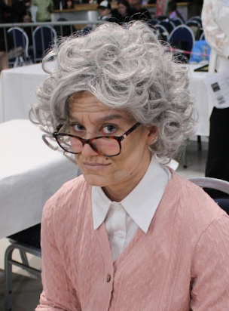
Comp 5: Theatrical Ageing Make-up
2nd Place | 3rd Place | 4th Place
Lola Richardson Newcastle (NE) | Neve Bernard Stockton Riverside (NE) | Phoebe Douglas Middlesborough (NE)

Slide 12
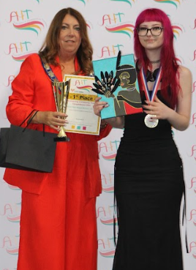
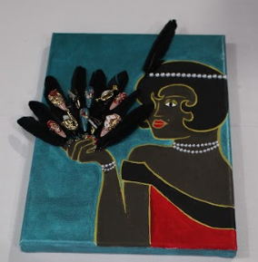
Comp 6: Creative Nails
Theme: Art Deco
1st Place
Competitor: Sage Donohue
College: Chesterfield
North West

Slide 13
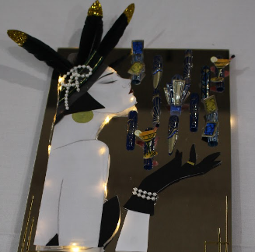
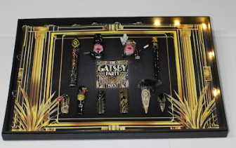
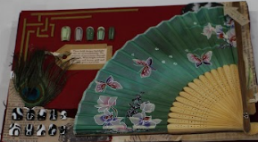
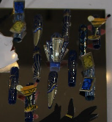
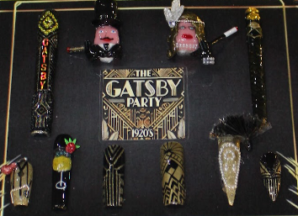
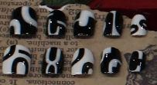
Comp 6: Creative Nails – Art Deco
2nd Place | 3rd Place | 4th Place
Lily Carlin CCSW Ellesmere (NW) | Olivia Mitchell Redcar & Cleveland (NE) | Imogen Merrie Sunderland (NE)

Slide 14
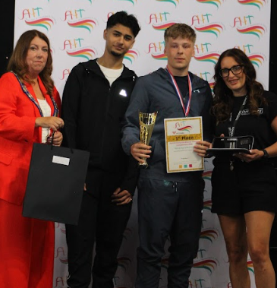
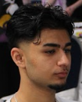
Comp 7: Barbering Cut & Finish
1st Place
Competitor: Theo Burns
College: Edinburgh
Scotland

Slide 15
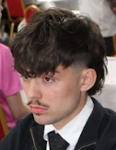
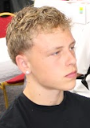
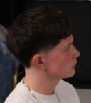
Comp 7: Barbering Cut & Finish
2nd Place | 3rd Place | 4th Place
Adam Howliston Northumberland (NE) | Corben Shaw Loughborough (Mid) | Joe Wood Kirklees (NW)

Slide 16
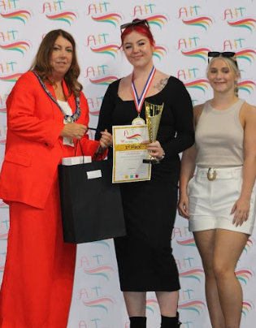
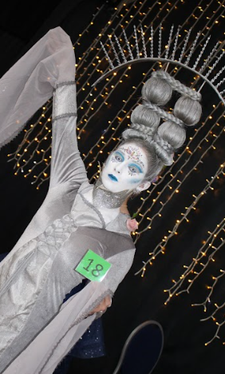
Comp 9: Fantasy Hairdressing – Total Look
1st Place
Competitor: Molly Gardner
College: The Academy
Scarborough
North East

Slide 17
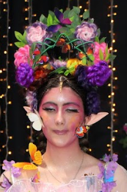
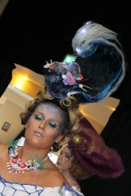
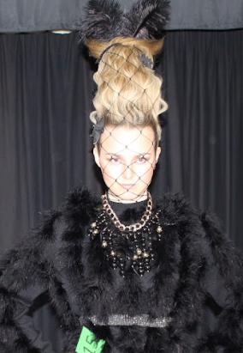
Comp 9: Fantasy Hairdressing – Total Look
2nd Place | 3rd Place | 4th Place
Daria Iszydorczyk Merthr (Wales) | Kelly Holden Tyne Coast (NE) | Jess Maundrell West Suffolk (Mid)

Slide 18
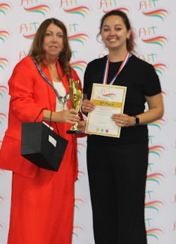
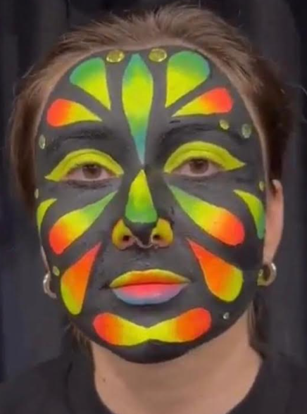
Comp 10: Face Painting - Carnival
1st Place
Competitor: Yana Hatsenko
College: UCW
South West

Slide 19
Comp 10: Face Painting - Carnival
2nd Place | 3rd Place | 4th Place
Isla Derrick Chesterfield (NW) | Ruby Johnson New College Durham (NE) | Ella Stocking Kirklees (NW)

Slide 20
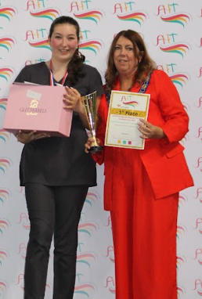
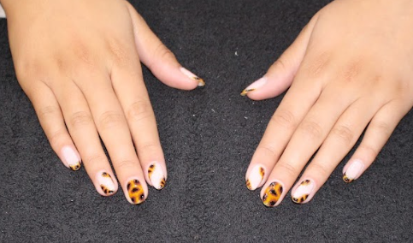
Comp 11: Commercial
Nail Art
Theme: Tortoiseshell
1st Place
Competitor: Ruby Linney
College: Tyne Coast, North East

Slide 21
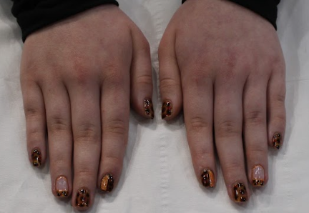


Comp 11: Commercial Nail Art – Tortoiseshell
2nd Place | 3rd Place | 4th Place
Alix MacDonald Tyne Coast (NE) | Georgie Mills Chesterfield (NW) | Hannah Whitehouse Halesowen (Mid)

Slide 22


Comp 12: Commercial Cut & Blow
1st Place
Competitor: Rosie Davies
College: Reds
Wales

Slide 23



Comp 12: Commercial Cut & Blow
2nd Place | 3rd Place | 4th Place
Katie Sime Reds (Wales) | Imogen Anderson Tyne Coast (NE) | Ezmae Fishwick Blackpool & Fylde (NW)

Slide 24


Comp 13: Bridal Hair Styling
1st Place
Competitor: Tegan Davies
College: Reds
Wales

Slide 25



Comp 13: Bridal Hair Styling
2nd Place | 3rd Place | 4th Place
Tasha Cosgrove IEG Stamford (mid) | Kelly Hill Preston (NW) | Sophie Harrison East Durham (NE)

Slide 26


Comp 15: Glamorous Drag Make-up
1st Place
Competitor: Phoebe Douglas
College: Middlesbrough
North East

Slide 27



Comp 15: Glamorous Drag Make-up
2nd Place | 3rd Place | 4th Place
Jennifer De Sousa NWSLC (Mid) | Madison Whitehead St Helens (NW) | Betty Culley NWSLC (Mid)

Slide 28


Comp 16: Masculine Beard (only cutting)
1st Place
Competitor: Tom Davies
College: Stoke on Trent
North West

Slide 29



Comp 16: Masculine Beard (cutting only)
2nd Place | 3rd Place | 4th Place
Lilya Marriner Tyne Coast (NE) | Jack Sweetman Manchester (NW) | Mallakai Godhard West Suffolk (Mid)

Slide 30

Comp 17: Nails Fashion Front Cover
Theme: AHT Logo
1st Place
Competitor: Liene Vasiliune
College: St Helens
North West

Slide 31





Comp 17: Nails Fashion Front Cover - AHT Logo
2nd Place | 3rd Place | 4th Place
Niamh Coffiy Sandwell (Mid) | Gracie Daniels Sandwell (Mid) | Jessica Worthington East Durham (NE)

Slide 32


Comp 18: Fashion Blow Dry (pre-cut & coloured mannequin)
1st Place
Competitor: Rosie Davies
College: Reds
Wales

Slide 33



Comp 18: Fashion Blow Dry (pre-cut & coloured mannequin)
2nd Place | 3rd Place | 4th Place
Katie Sime Reds (Wales) | Tegan Davies Reds (Wales) | Emma Jarvis Guernsey (Channel Islands)

Slide 34


Comp 19: Editorial Make-up Theme: Vogue
1st Place
Competitor: Harriet McFetridge
College: West Suffolk
Midlands

Slide 35



Comp 19: Editorial Make-up - Vogue
2nd Place | 3rd Place | 4th Place
Rose Lona Chesterfield LCG (NW) | Hannah Green Newcastle (NE) | Ruby Glowacki Bristol (SW)

Slide 36


Comp 20: Barbering Creative Cut & Finish
1st Place
Competitor: Justin Kasokota
College: New College Lanarkshire
Scotland

Slide 37



Comp 20: Barbering Creative Cut & Finish
2nd Place | 3rd Place | 4th Place
Jayden Hunt West Suffolk (Mid) | Liliya Marriner Tyne Coast (NE) | Aiden Dean Halesowen (Mid)

Slide 38


Comp 21: Theatrical Make-up
Theme: Create an Injury
1st Place
Competitor: Grace Taylor
College: Manchester
North West

Slide 39



Comp 21: Theatrical Make-up - Create an Injury
2nd Place | 3rd Place | 4th Place
Neve Bernard Stockton Riverside (NE) | Yana Hatsenko UCW (SW) | Maisy Paton NWSLC (Mid)

Slide 40


Comp 22: Feminine Bridal Make-up
1st Place
Competitor: Emily Wharton
College: Chesterfield LCG
North West

Slide 41



Comp 22: Feminine Bridal Make-up
2nd Place | 3rd Place | 4th Place
Hayley Snell West Suffolk (Mid) | Tyler Mumford NWSLC (Mid) | Lydia Pugsley-Daniels Bristol (SW)

Slide 42


Comp 23: Feminine Evening Style
1st Place
Competitor: Katie Sime
College: Reds
Wales

Slide 43



Comp 23: Feminine Evening Style
2nd Place | 3rd Place | 4th Place
Rosie Davies Reds (Wales) | Tiegan Swales Hartlepool (NE) | Jamie Easton West Lothian (Scotland)

Slide 44



Comp 24: Create an Image Based on a Theme – Moulin Rouge
1st Place
Competitors: Ellie Smith & Billie Moore
College: New College Lanarkshire, Scotland

Slide 45



Comp 24: Create an Image Based on a Theme – Moulin Rouge
2nd Place | 3rd Place | 4th Place
Betty Culley & Amelia Hayward NWSLC (Mid) | Lilly York & Emily Pearce St Helens (NW) | Mackenzie Braid & Lilly Burridge Gateshead (NE)

Slide 46


Comp 25: Creative Mixed Media Nails
Theme: Fantasy
1st Place
Competitor: Mia Rutterford
College: West Suffolk
Midlands

Slide 47



Comp 25: Creative Mixed Media Nails - Fantasy
2nd Place | 3rd Place | 4th Place
Melissa Kenyon St Helens (NW) | Alyliyah Hatter NWSLC (Mid) | Natasha Bilton Hull (NE)

Slide 48


Comp 26: Feminine Textured Hair Freestyle
1st Place
Competitor: Ellis Lee
College: New College Lanarkshire
Scotland

Slide 49



Comp 26: Feminine Textured Hair Freestyle
2nd Place | 3rd Place | 4th Place
Kiraanjit Kaur Sandwell (Mid) | Jamie Henderson New College Lanarkshire (Scot) | Toni-Lee Mann Sandwell (Mid)

Slide 50

AHT Awards: Excellent Student of the Year
Sponsored by: Qualifi
Winner: Jamie Henderson
College: New College Lanarkshire

Slide 51

2025 Best Overall Area at National Finals
1st Place - North East
Presented to Lindsey Deswert
North East Chairperson
2nd - Midlands
3rd - North West

Slide 52

The Blooming Marvelous Award
in memory of Sue Bleasdale
Presented to the top college
at National finals
Winners: Reds
Area: Wales

