Slide 1

AHT Direct Entry
Competitions
11th and 13th May 2025
Blackpool

Slide 2
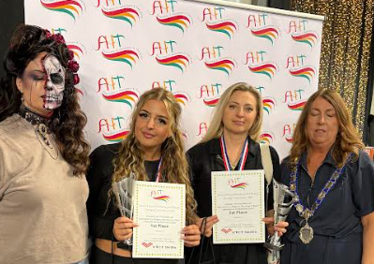
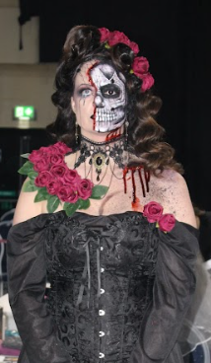
Comp 1: Fantasy Hair & Make-up
1st Place
Competitor: Olga Buhaleva & Tyler Mumford
College: North Warwickshire & South Leicestershire (NCSLC)

Slide 3
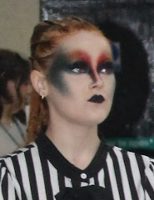
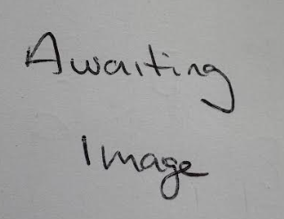
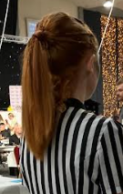
Comp 1: Fantasy Hair & Make-up
2nd Place | 3rd Place | 4th Place
Lily York & Heather Carragher North Warwickshire & South Leicestershire | Anna Reshetniava & Danni-Leigh Nelson St Helens | Sophie Hays & Danielle Wood New College Lanarkshire

Slide 4
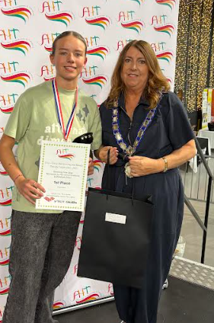
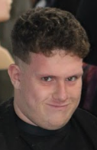
Comp 2: Barbering Freestyle
1st Place
Competitor: Liliya Marriner
College: Tyne Coast

Slide 5
Comp 2: Barbering Freestyle
2nd Place | 3rd Place | 4th Place
N/A | N/A | N/A

Slide 6
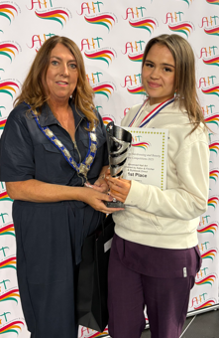
Comp 3: Advanced Nail Art
Mirror Image
Theme: Gothic Wedding
1st Place
Competitor: Melissa Kenyon
College: St Helens

Slide 7
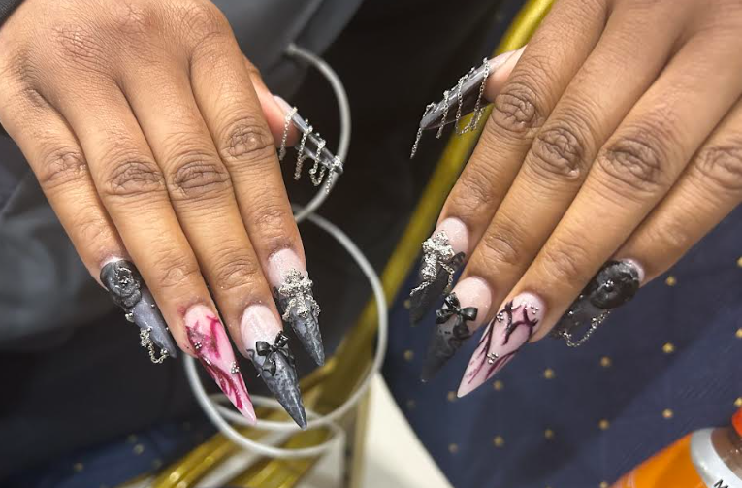
Comp 3: Advanced Nail Art Mirror Image - Gothic Wedding
2nd Place | 3rd Place | 4th Place
Mia Jukes Sandwell | Ruby Arnold St Helens | Liene Vasiliune St Helens

Slide 8
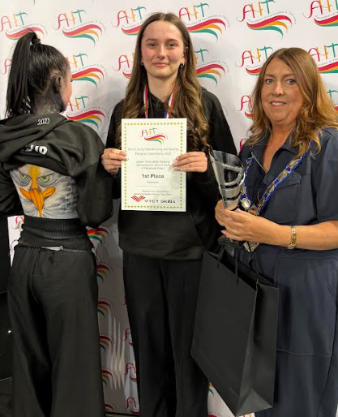
Comp 4: Body Painting Theme: Birds of Paradise
1st Place
Competitor: Hannah Tempest
College: NWSLC

Slide 9
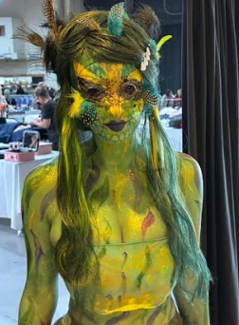
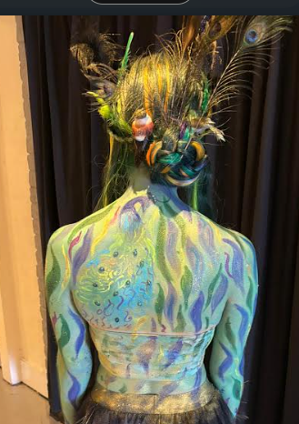
Comp 4: Upper Torso Body Painting - Birds of Paradise
2nd Place | 3rd Place | 4th Place
Ellise Faulkner North Warwickshire & South Leicestershire | Karolina Zebrowska Blackpool & Flyde | Lorna Cook West Anglia

Slide 10
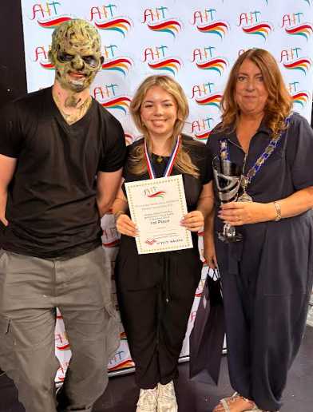
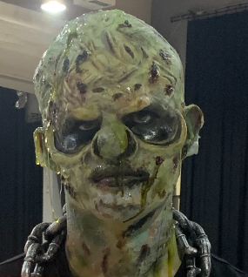
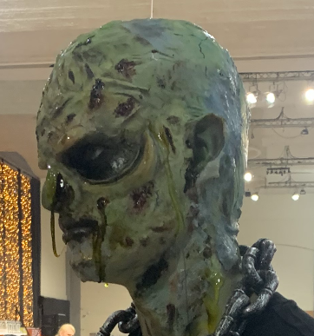
Comp 5: Prosthetics Theme: Trolls & Goblins
1st Place
Competitor: Jess Mackie
College: Weston

Slide 11
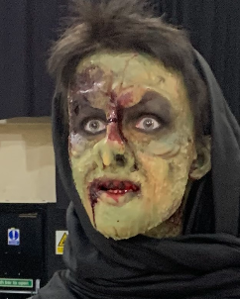
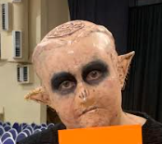
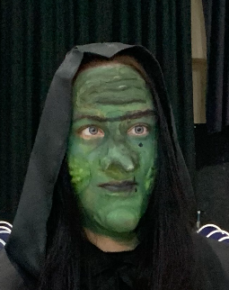
Comp 5: Prosthetics - Trolls & Goblins
2nd Place | 3rd Place | 4th Place
Amelia Heyward North Warwickshire & South Leicestershire | Sonia Gillman Weston | Lucy Randalls St Helens

Slide 12
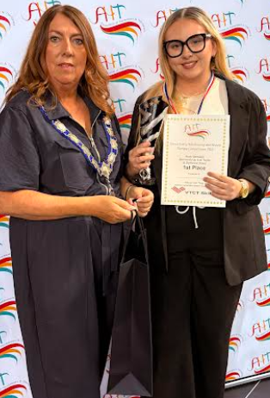
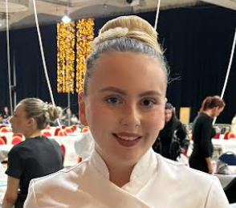
Comp 6: Body Massage
1st Place
Competitor: Ellie Grimshaw
College: Weston

Slide 13
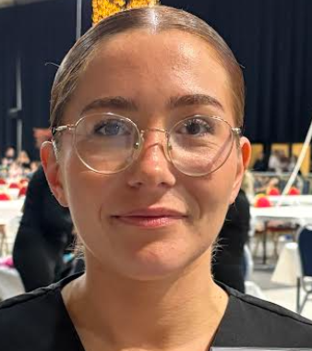
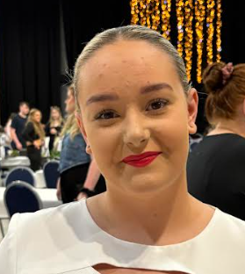
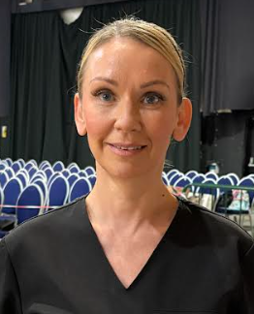
Comp 6: Body Massage
2nd Place | 3rd Place | 4th Place
Jasmine Graham Blackpool & Fylde | Leona Lyons Tyne Coast | Louise Allen Blackpool & Fylde

Slide 14
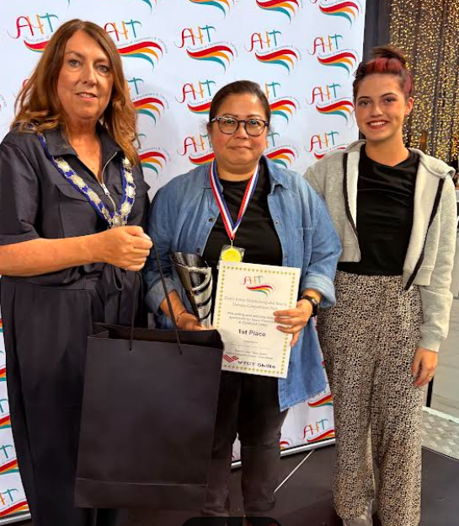
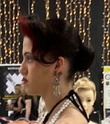
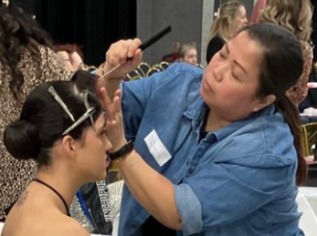
Comp 7: Pre-Set Styling (on model or block)
1st Place
Competitor: Cherry Brownlea
College: New College Lanarkshire

Slide 15
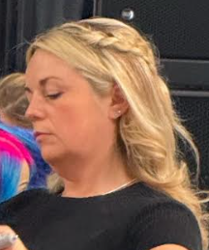
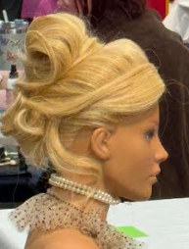
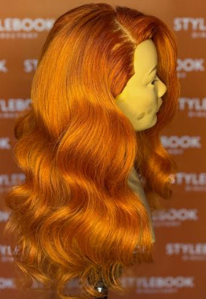
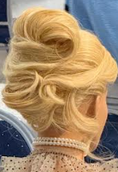
Comp 7: Pre-Set Styling (on model or block)
2nd Place | 3rd Place | 4th Place
Rebecca Murdoch Edinburgh | Larysa Jamison Edinburgh | Tegan Davies Reds

Slide 16
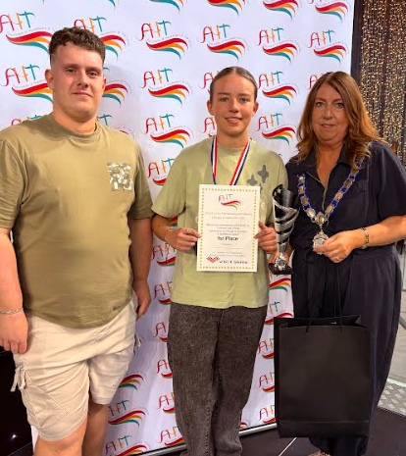
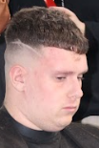
Comp 8: Masculine Commercial Cut & Finish on Textured Hair
1st Place
Competitor: Liliya Marriner
College: Tyne Coast

Slide 17
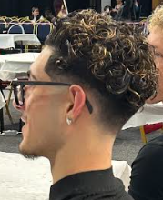
Comp 8: Masculine Creative Cut & Finish on Textured Hair
2nd Place | 3rd Place | 4th Place
Seth Sungh Sandwell | N/A | N/A

Slide 18
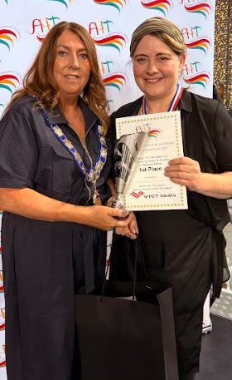
Comp 9: TV Film Make-up
Theme: Dickensian Character
1st Place
Competitor: Vicki Teggart
College: NWSLC

Slide 19
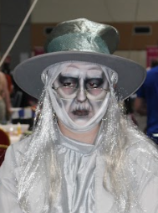
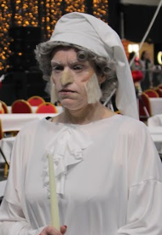
Comp 9: TV Film Make-up - Dickensian Character
2nd Place | 3rd Place | 4th Place
Maddison Whitehead St Helens | Neve Barnard Stockton | Betty Culley North Warwickshire & South Leicestershire

Slide 20
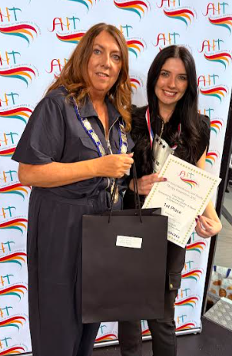
Comp 10: Vivid Hair
1st Place
Competitor: Heather Carragher
College: St Helens

Slide 21
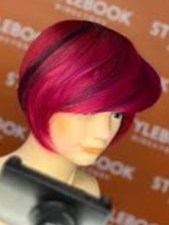
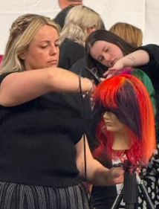
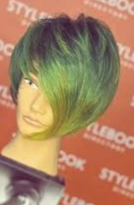
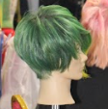
Comp 10: Vivid Hair
2nd Place | 3rd Place | 4th Place
Katie Sime Reds | Brooke Anderson Edinburgh | Rosie Davies Reds

Slide 22
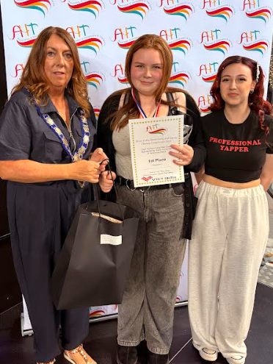
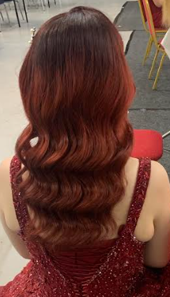

Comp 11: AHT Skills Feminine Long Hair Fashion
1st Place
Competitor: Chelsea Hudson
College: West Anglia

Slide 23
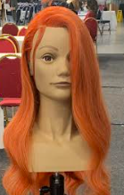
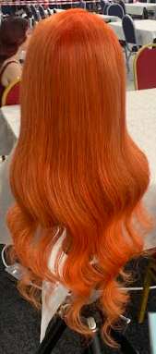
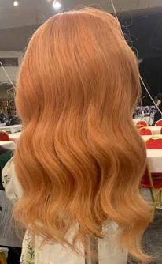
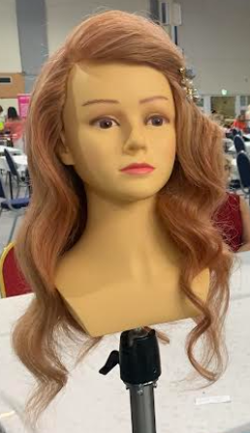
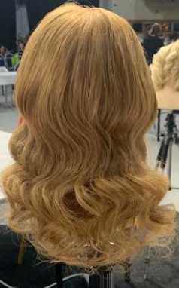
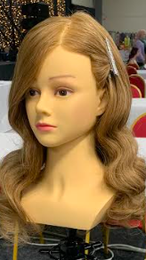
Comp 11: AHT Skills Feminine Long Hair Fashion
2nd Place | 3rd Place | 4th Place
Rosie Davies Reds | Cherry Brownlee New College Lanarkshire | Imogen Anderson Tyne Coast

Slide 24
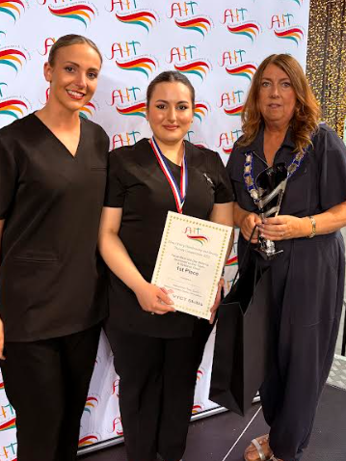

Comp 12: Beauty Facial & Day Make-up
1st Place
Competitor: Ava Brimo
College: Blackpool & Fylde

Slide 25



Comp 12: Beauty Facial & Day Make-up
2nd Place | 3rd Place | 4th Place
Leona Lyons Tyne Coast | Tilly Osborne North Warwickshire & South Leicestershire | Lola Beesley North Warwickshire & South Leicestershire

Slide 26



Comp 13: Masculine Finish on a Block
1st Place
Competitor: Liliya Marriner
College: Tyne Coast

Slide 27



Comp 13: Masculine Finish on a Block
2nd Place | 3rd Place | 4th Place
Caitlin Beaney Sunderland | Ellis Lee New College Lanarkshire | Emily Mooney Sunderland

Slide 28



Comp 14: Masculine Natural Make-up
1st Place
Competitor: Neve Dunn
College: Tyne Coast

Slide 29


Comp 14: Masculine Natural Make-up
2nd Place | 3rd Place | 4th Place
Neve Bernard Stockton | Jenni Desuza North Warwickshire & South Leicestershire | Vicki Teggart North Warwickshire & South Leicestershire
 | Did not want photo taken

Slide 30


Comp 15: Non Gel Polish
(Red & French)
1st Place
Competitor: Gracie Daniels
College: Sandwell

Slide 31
Comp 15: Non Gel Polish - Red & French
2nd Place | 3rd Place | 4th Place
Caitlin Rey North Warwickshire & South Leicestershire | Neve Power Tyne Coast | Ellie Grimshaw Weston

Slide 32



Comp 16: Ageing TV Make-up
1st Place
Competitor: Ruby Harmer
College: NWSLC

Slide 33






Comp 16: Ageing TV Make-up
2nd Place | 3rd Place | 4th Place
Abbie Harkness New College Lanarkshire | Neve Bernard Stockton | Neve Dunn Tyne Coast

Slide 34


Comp 17: Masculine Long Hair Finish (on a Block)
1st Place
Competitor: Ellis Lee
College: New College Lanarkshire

Slide 35



Comp 17: Masculine Long Hair Finish (on a Block)
2nd Place | 3rd Place | 4th Place
Jamie Henderson New College Lanarkshire | Dale Cook Derwentside | Liliyia Marrimer Tyne Coast

Slide 36



Comp 18: Catwalk Hair
1st Place
Competitor: Katie Sime
College: Reds

Slide 37






Comp 18: Catwalk Hair
2nd Place | 3rd Place | 4th Place
Brook Anderson Edinburgh | Jessica Wells Auchterlonie Tyne Coast | Taylor Thompson Tyne Coast

Slide 38


Comp 19: Masculine Make-up: Screen/Editorial
1st Place
Competitor: Leah Coulson
College: St Helens

Slide 39



Comp 19: Masculine Make-up - Screen or Editorial
2nd Place | 3rd Place | 4th Place
Betty Culley North Warwickshire & South Leicestershire | Charlotte McDonnagh St Helens | Neve Bernard Stockton

Slide 40


Comp 20: Fantasy Make-up
Theme: Illusion
1st Place
Competitor: Nimah Sheehan
College: NWSLC

Slide 41



Comp 20 (Monday): Fantasy Make-up - Illusion
2nd Place | 3rd Place | 4th Place
Csenge Molnar St Helens | Kiya Wacker West Anglia | Abigail Robinson Weston

Slide 42


Comp 21 (Monday): Current Barbering trends with Beards
1st Place
Competitor: Jayden Hunt
College: West Suffolk

Slide 43



Comp 21 (Monday): Current Barbering trends with Beards
2nd Place | 3rd Place | 4th Place
Mathew Hoggan Edinburgh | Liliya Marrimer Tyne Coast | Santino Salmon Stoke on Trent

