Slide 1
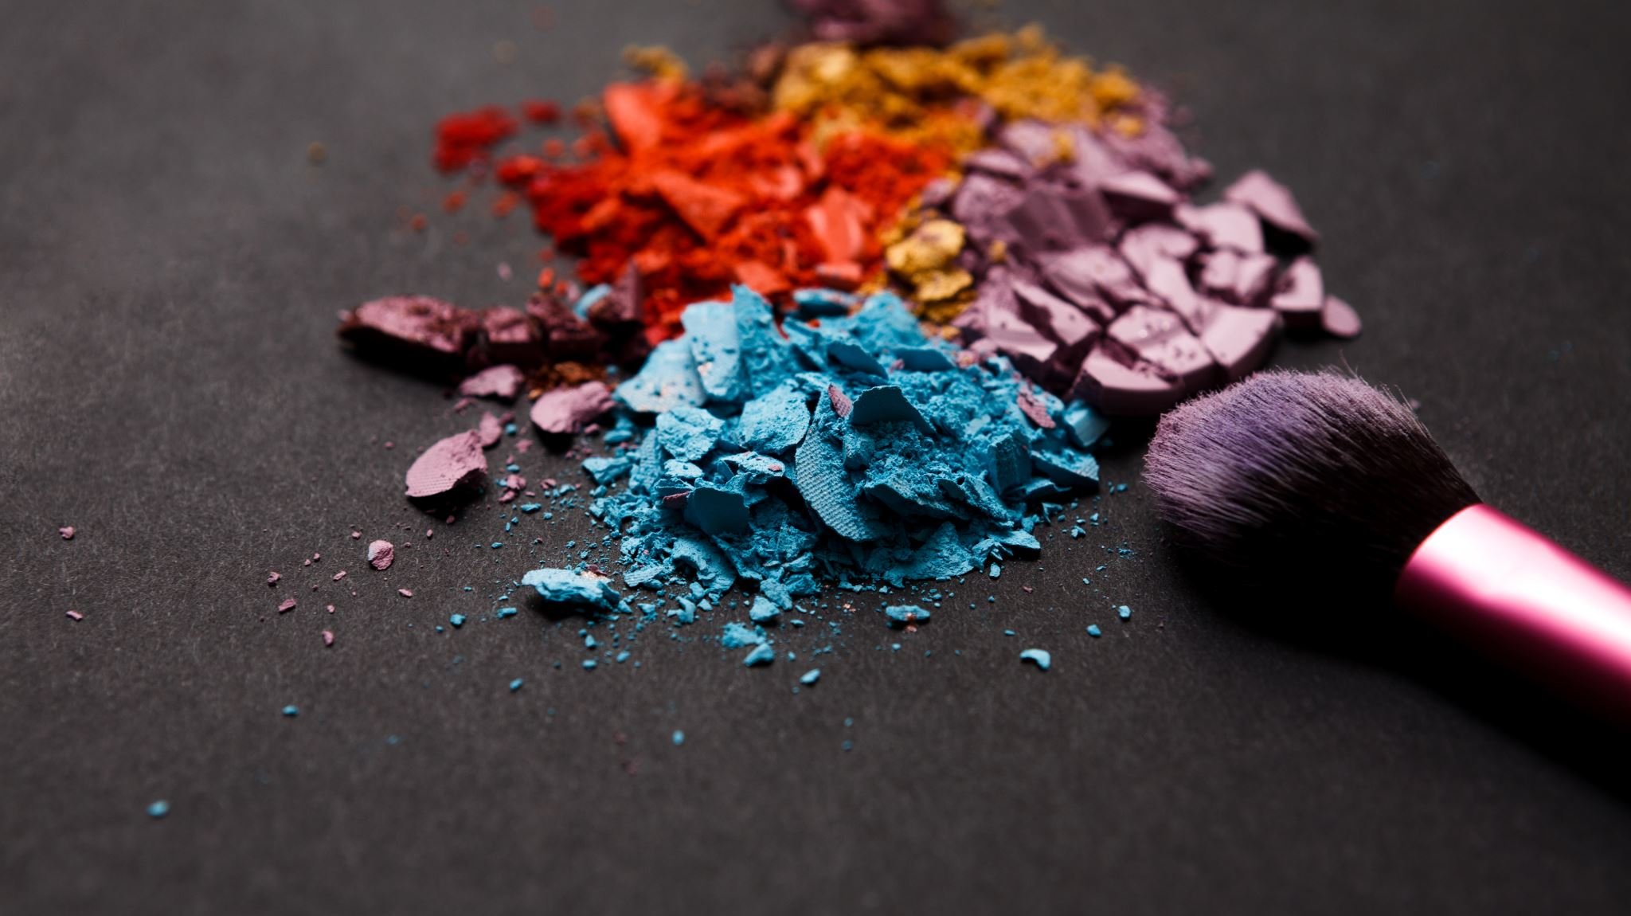
Editorial Make up
Competition No. 18- 1pm

Slide 2
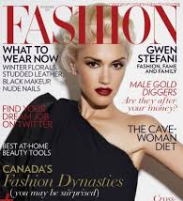
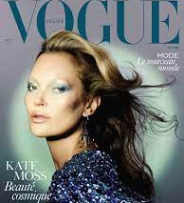
Example of Front Cover
Front Covers should have heading of Magazine or Own Magazine Name.
Text
Image
Be In color
Any Useful Inspiration to support the look

